Slide 1


Titolo presentazione sottotitolo
Localization, Navaigation and Smart Mobility
Project activity 2019/2020
Carminati Fabio, mat. 919803
Gallone Emanuele, mat. 914114
Milano, XX mese 20XX

Slide 2
Introduction
With the competences acquired during the Localization Navigation and Smart Mobility course we will now propose and discuss the solutions for the tasks 1,2,3,4,5,6 through the use of Matlab code.
It is possible to fetch both the Matlab Figure as well as the performances matrixes from which the graphs that will be shown are taken
Tic and Toc matlab functions have been used for evaluating the execution time of the various tasks

Slide 3
Assumptions
Scenario area: 2D location area of 4000*4000 m where the x-axis range is
[-2000 2000] while the y-axis range is [-2000 2000]
Only one user at each time in the simulated scenario
The number of APs and their location is computed at task 1 and assumed to be constant for all the following tasks
The R matrix is computed at task 2 and assumed to be constant for all the following tasks
In the Matlab code there are switches that enables a custom run of the code (i.e. decide each time which tasks to run)
Since tasks 1,2 are mandatory for the tasks 3,4,5,6 their switches refer just to the plot of the results
The code is organized in functions in order to improve its readability

Slide 4
Task 1
Task 2
Task 3
Task 4
Task 5
Task 6

Slide 5
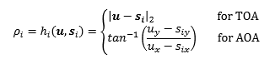
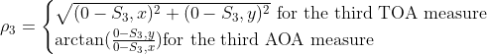
Task1a:Learn the position of the APs
Reference point in u=[0 0]
Since there is no noise in the given TOA and AOA measurements we will obtain exactly the true APs location
Solution algorithm: insert into the following system the TOA and AOA measurements of the various APs using as u coordinates the reference point
For the third Access Point the formula becomes:

Slide 6
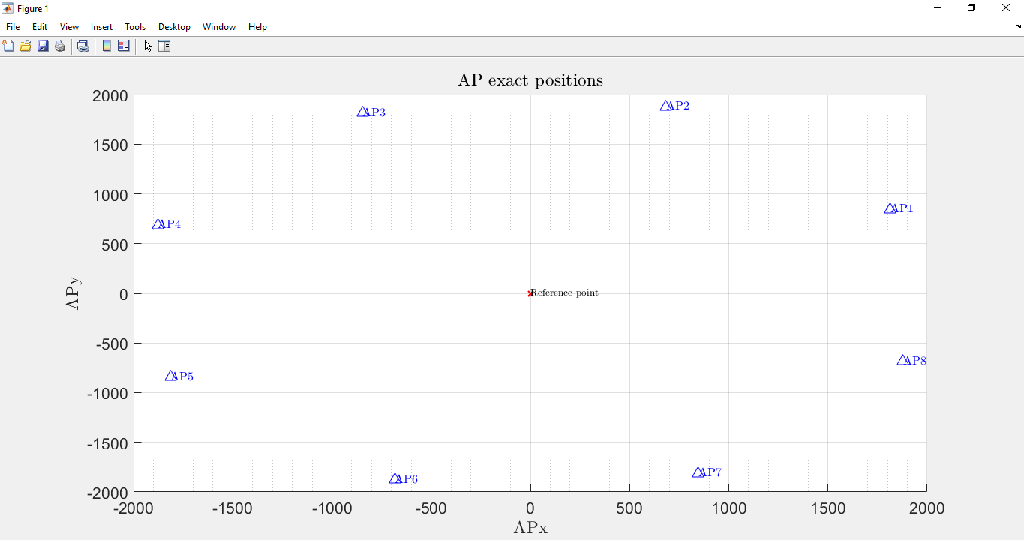
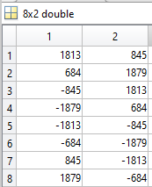
Task1a:Results
LNSM_Project\Performances_and_results\Task1

Slide 7
Task1b:Covariance Matrix of TOA measurements
Reference point is now u=[500 -800]
R matrix is computed using:
The given 5000 rho measurements for each of the APs ( i.e. )
The exact location of the APs found at task 1a (i.e. we can compute h(u) using the Euclidean distance)
Since for each AP we need to:
Obtain 5000 n values and compute their covariances
Round these covariances values and place them into a diagonal matrix: we have now computed R

Slide 8
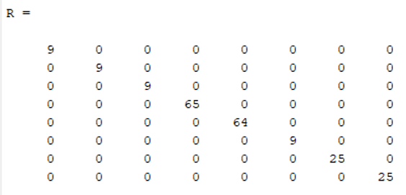
Task1b-Results
LNSM_Project\Performances_and_results\Task1\R_matrix.mat

Slide 9
Task 1
Task 2
Task 3
Task 4
Task 5
Task 6

Slide 10
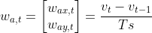
Task2:Learning the motion model dataset for motion models
After an analysis of the given trajectories dataset we realize that they refer to a M3-Random Force motion model since:
User coordinates (U_{x},U_{y}) and velocity(V_{x},V_{y}) are given
V_{x},V_{y} have a not zero mean
There is a random acceleration process w_{a,t} that resembles a gaussian distribution with almost zero mean and variance different from 0
As regards the w_{a,t} :
Compute w_{a,t} as: for all 100 trajectories
Compute the mean and variance of the overall w_{a,t}

Slide 11
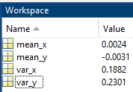
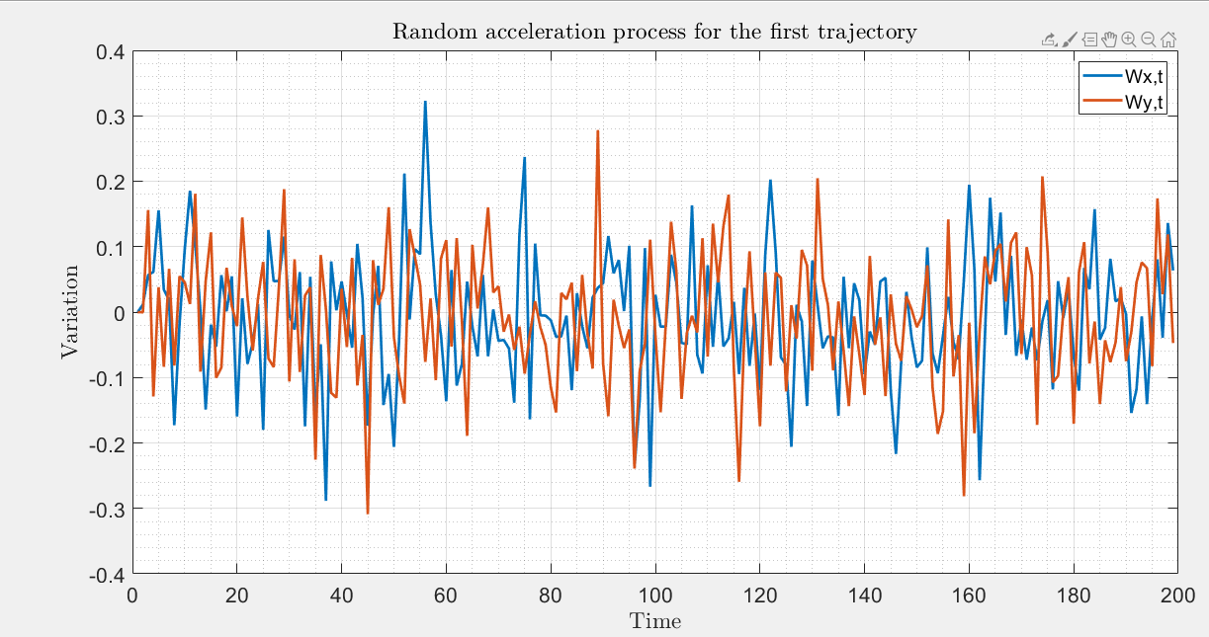
Task2:Results
LNSM_Project\Performances_and_results\Task2

Slide 12
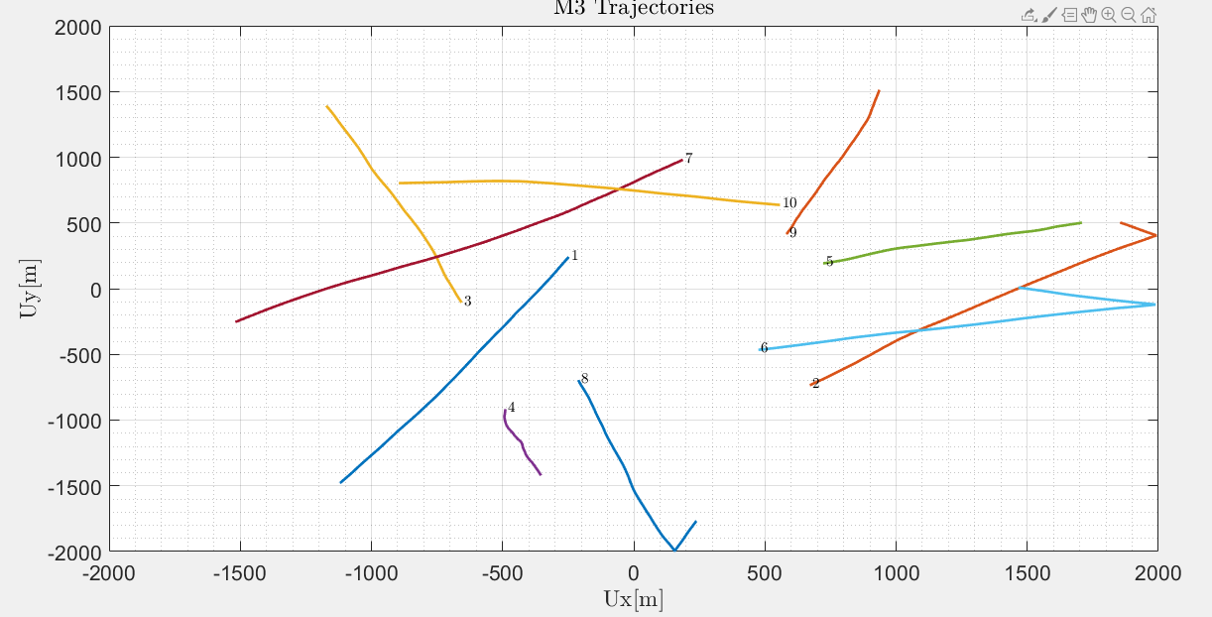
Task2:Plot the first 10 trajectories that refers to an M3 model
LNSM_Project\Performances_and_results\Task2

Slide 13
Task 1
Task 2
Task 3
Task 4
Task 5
Task 6

Slide 14
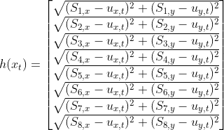
Task3:Kalman filter testing on known trajectory
Since we have TOA measurements the expression is:
It is immediately clear that is not linear thus we need to use an Extended Kalman Filter(EKF).
For the details about how the EKF is implemented we suggest a code inspection.
In order to be able to perform both the Prediction and the Update step we need to do some precomputation.

Slide 15
Task3:Precomputation and assumptions
From the M3 motion model we fetch :
F = [eye(2) , Ts*eye(2);
zeros(2,2) , eye(2)];
L = [0.5*Ts^2*eye(2);Ts*eye(2)];
v(:,1) = [7;2];
x = [zeros(2,TotalSimulationTime);v];
x(:,t) = F*x(:,t-1) + L*w;
Q=sigma_squared_a*(L*L’);
F,Q are assumed to be time invariant
P is initialized with an eye(4);
X is initialized with the first point of the trajectory
For the performance evaluations we compute and store the C matrix, sigma_h (drms) and CEP95 values for all the elements of a trajectory

Slide 16
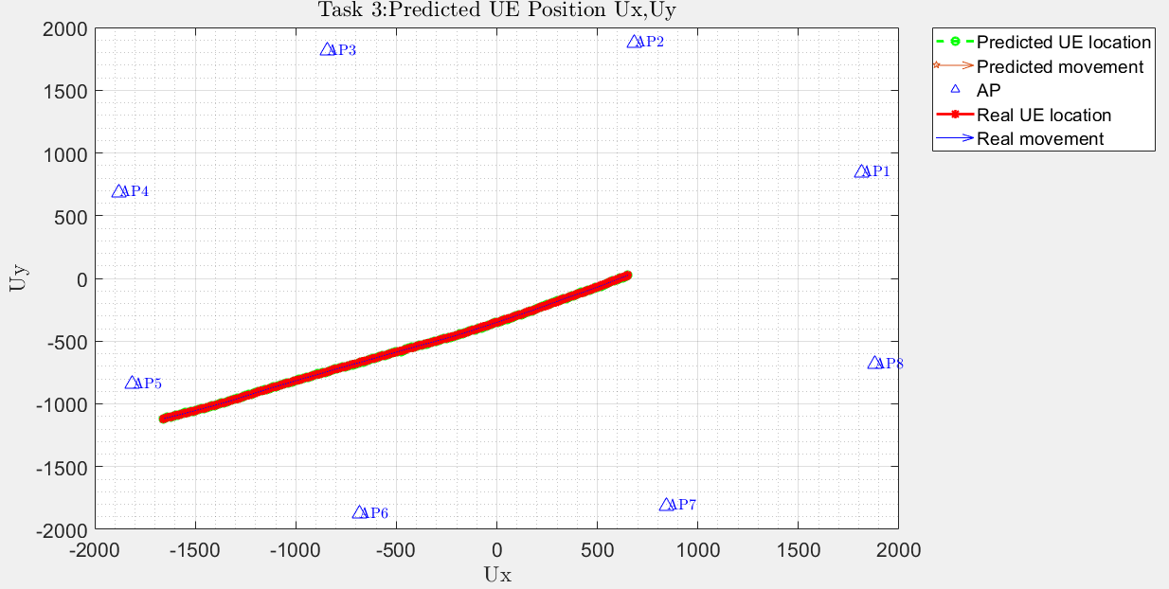
Task 3:trajectory #35
LNSM_Project\Plots\Task3

Slide 17
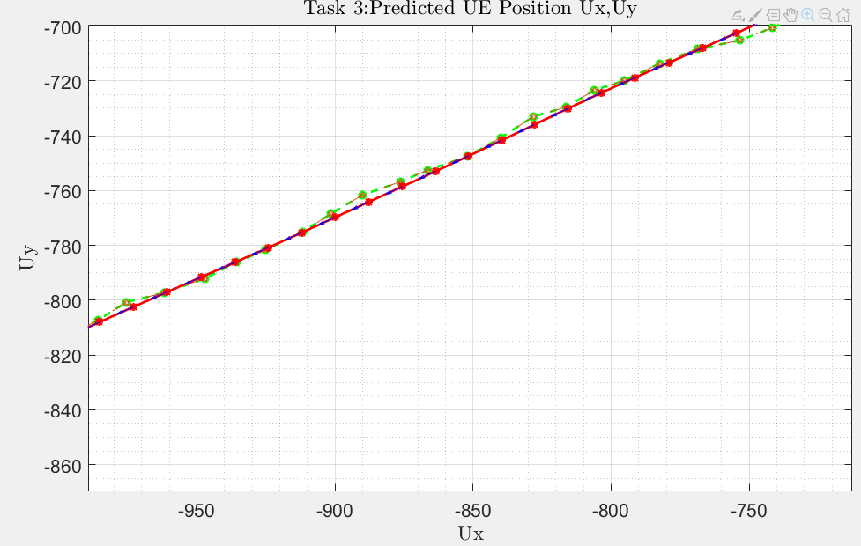
Task 3:trajectory #35 Details

Slide 18
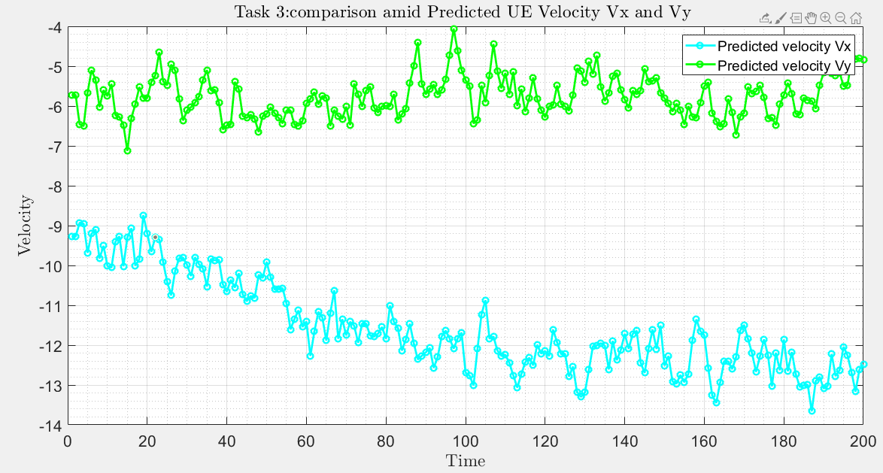
Task3:trajectory #35

Slide 19
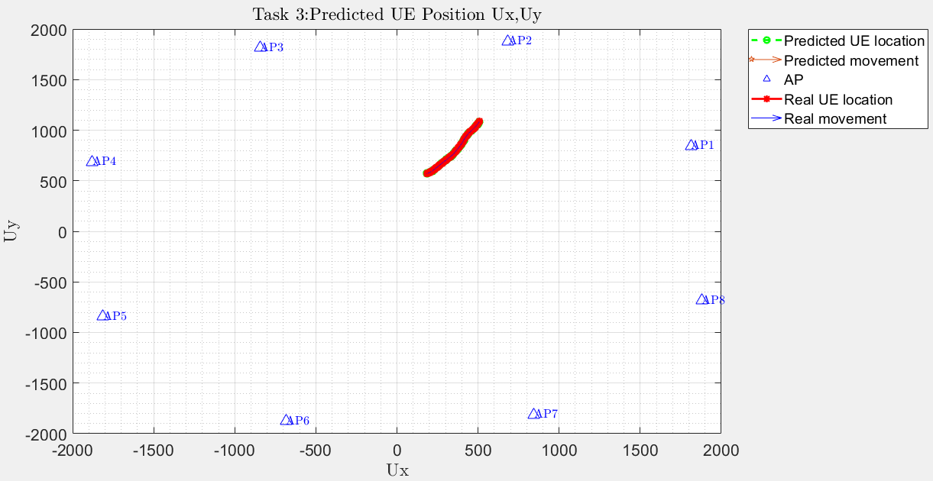
Task 3:trajectory #72
LNSM_Project\Plots\Task3

Slide 20
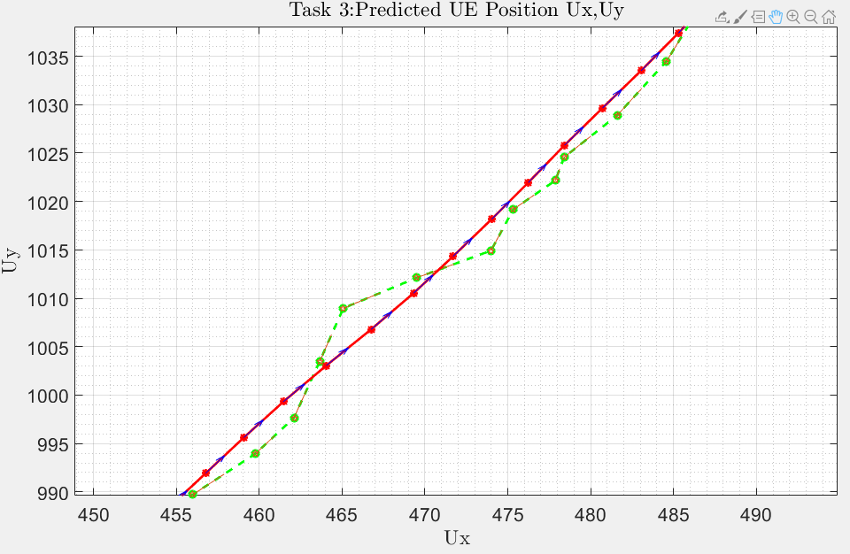
Task 3:trajectory #72 Details

Slide 21
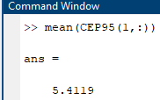
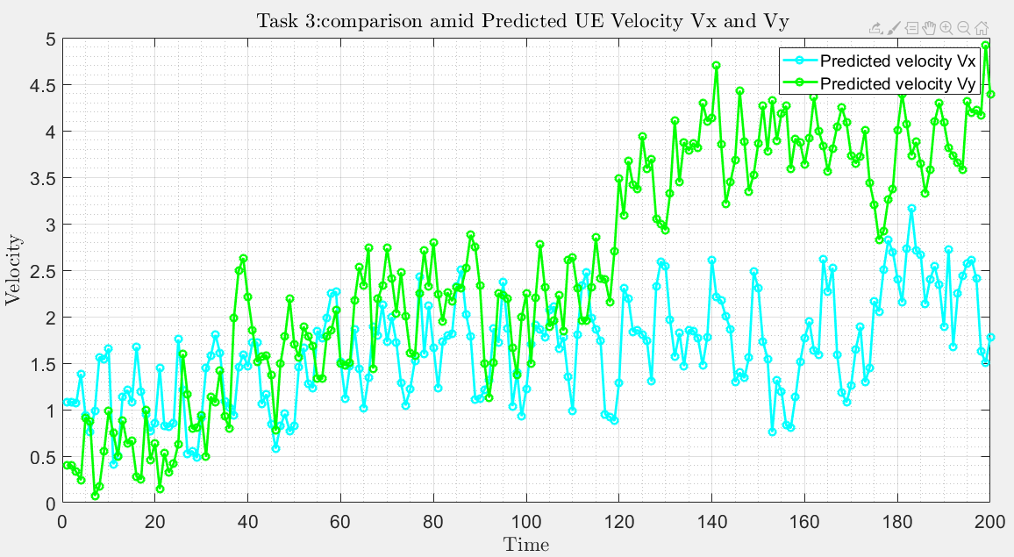
Task 3:trajectory #72

Slide 22
Task 1
Task 2
Task 3
Task 4
Task 5
Task 6

Slide 23
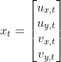
Task4: Kalman filter testing on unknown trajectory
W.r.t. task 3 we don’t have a priori knowledge of the user trajectory; thus we need to build at each step:
The estimation of the user location (U_{x},U_{y}) is done step by step through iterative NLS algorithm
As regards the velocities (V_{x},V_{y}):
For the first element: V_{x}=50 km/h (13.88 m/s) as the text says while V_{y}=0 m/s since nothing is said
(V_{x},V_{y}) both equal to 0 m/s for the following steps since nothing is said
In order to evaluate whether our iterative NLS implementation was correct or not we test it over a known trajectory (trajectory # 5 of task 2). From that experimental try we found that iterative NLS provides an adequate estimation after 4 iterations.
We expect that a degradation of the accuracy metrics w.r.t. task 3 where the user trajectory was known
Greater resolution time w.r.t. task 3 due to NLS algorithm

Slide 24
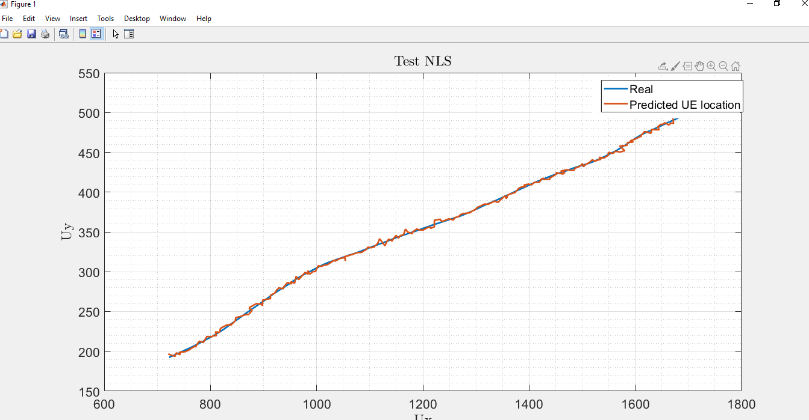
Task 4: Iterative NLS evaluation
The next step could be to use WNLS instead of NLS

Slide 25
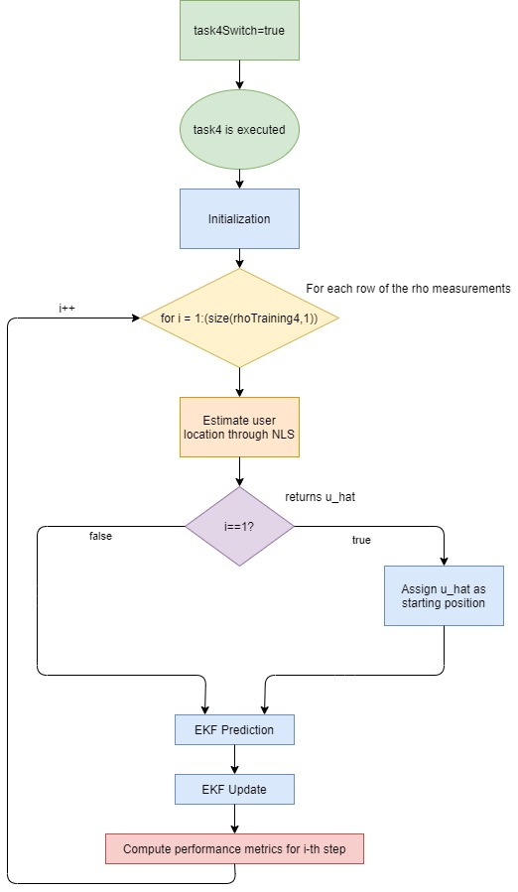
The algorithm for
task 4 resolution is:

Slide 26
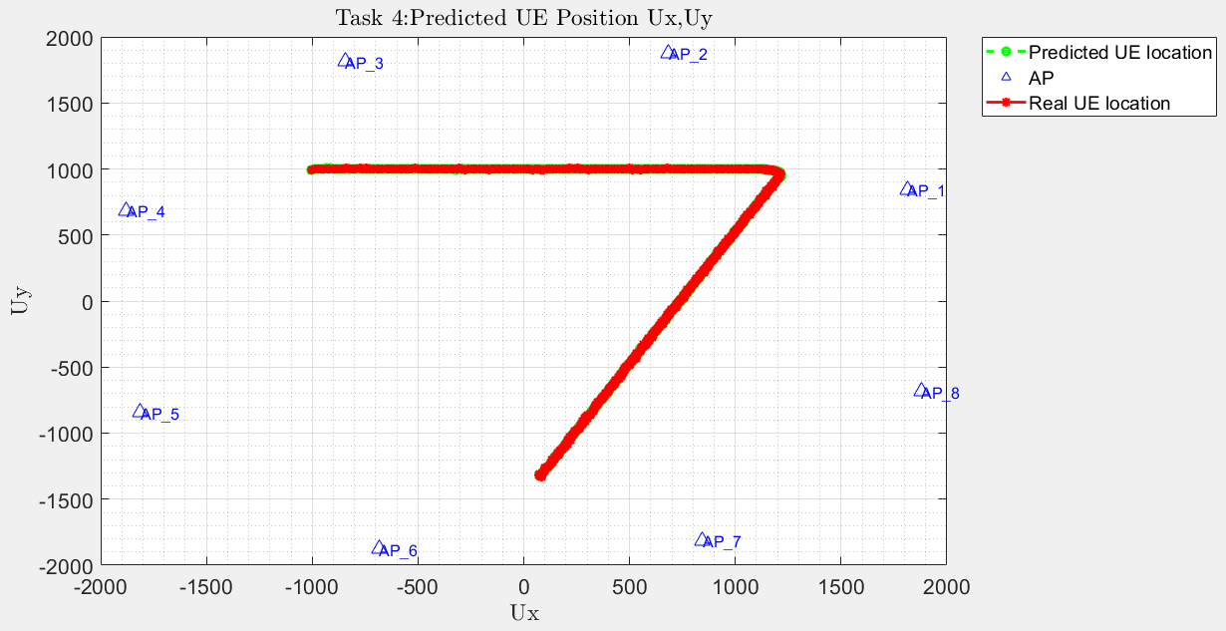
Task4: Trajectory
LNSM_Project\Plots\Task4
A small note: Real UE location refers to the one calculated through iterative NLS

Slide 27
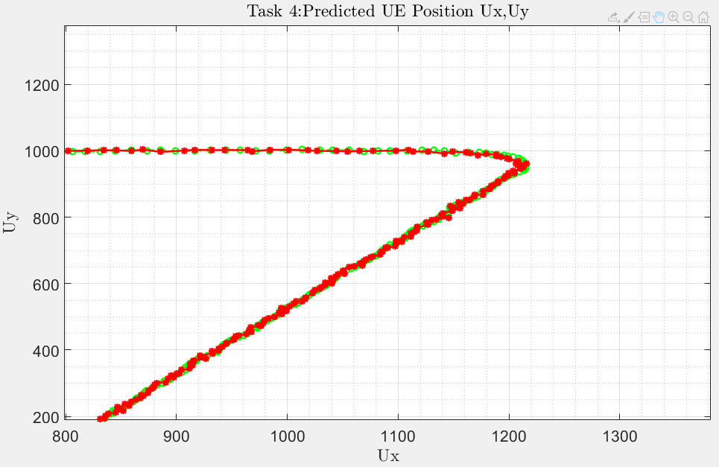
Task4: Trajectory details

Slide 28
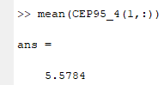
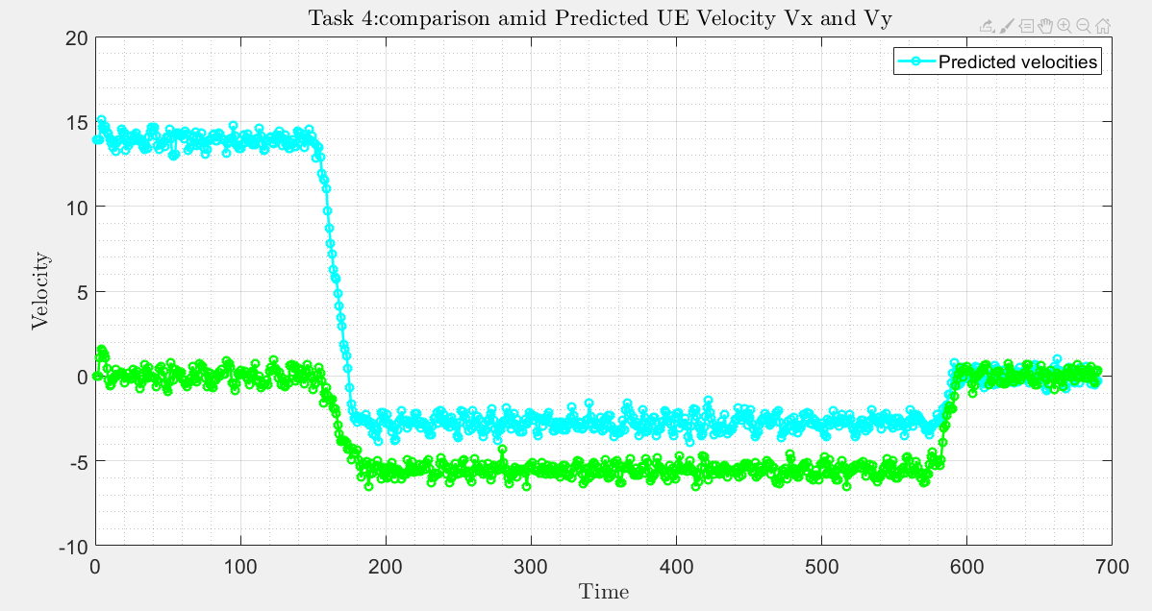
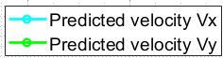
Task4: Velocities

Slide 29
Task 1
Task 2
Task 3
Task 4
Task 5
Task 6

Slide 30
Task 5: Kalman filter testing on unknown trajectory
As for task 4 we don’t have a priori knowledge of the user trajectory; thus we need to build at each step:
The estimation of the user location (U_{x},U_{y}) is done step by step through iterative NLS algorithm with 4 iterations (such that we can compare the results with task 4)
As regards the velocities (V_{x},V_{y}):
(V_{x},V_{y}) both equal to 0 m/s since nothing is said
Then apply EKF (i.e. redo exactly the task 4 algorithm)

Slide 31
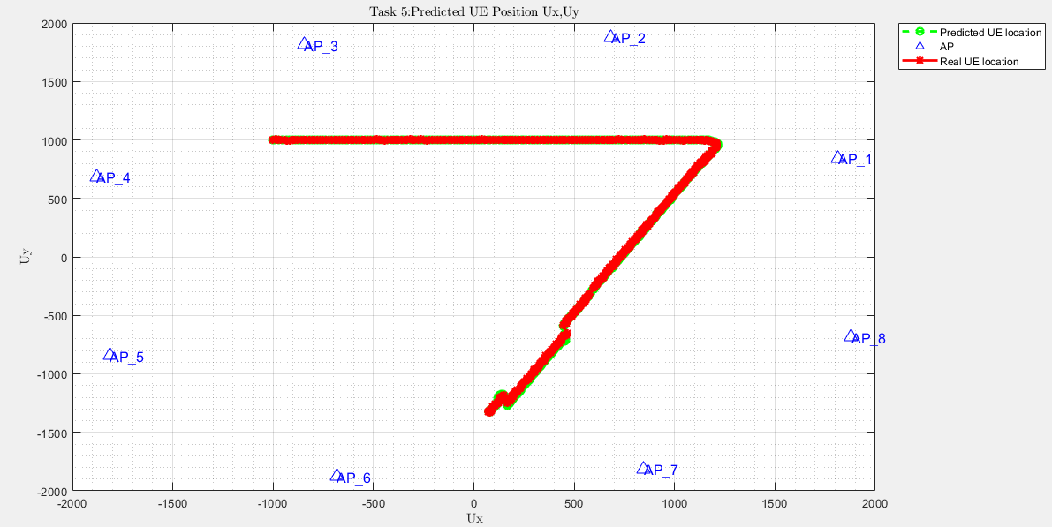
Task 5: Trajectory
LNSM_Project\Plots\Task5
A small note: Real UE location refers to the one calculated through iterative NLS

Slide 32
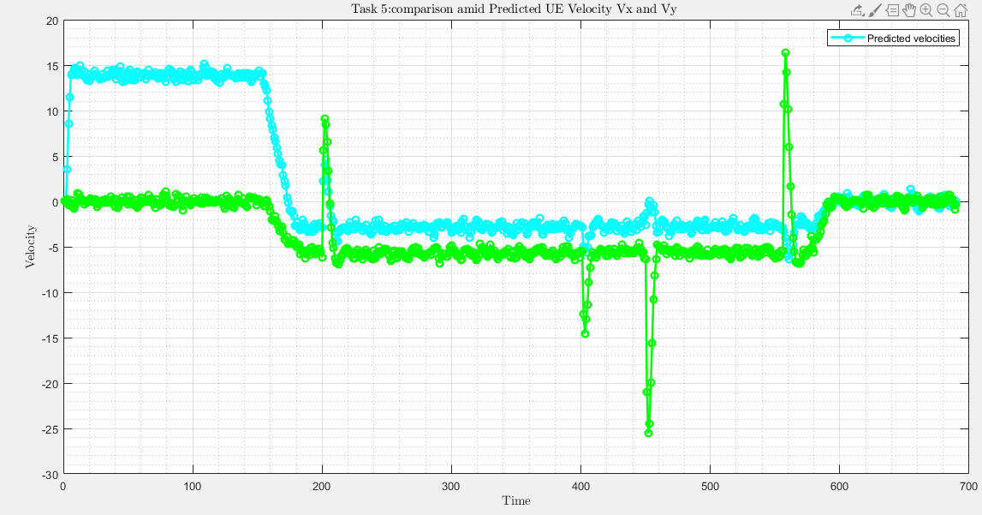
Task 5: Velocities

Slide 33
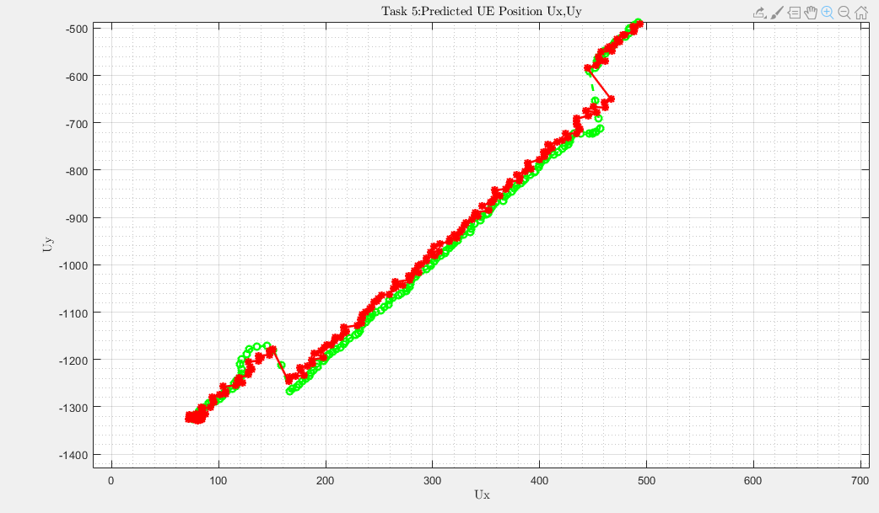
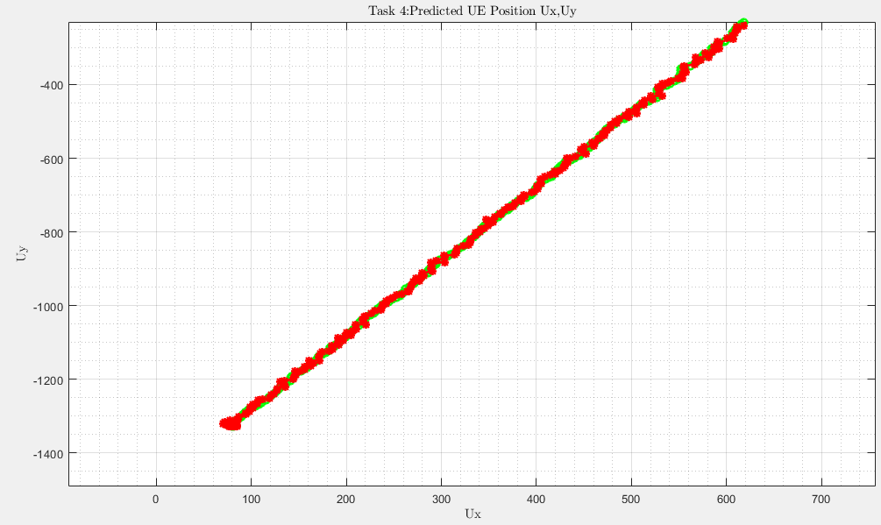
Task 5 vs task 4 trajectory details:

Slide 34
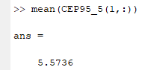
Task 5: Results
Degradation of the accuracy metrics w.r.t. task 3 where the user trajectory was known
Task 4 and task 5 have almost the same accuracy
Greater resolution time w.r.t. task 3 due to NLS algorithm
Same resolution time of task 4 since they both follow the same algorithm
If we observe carefully the trajectories we can see that task 4 and 5 follow the same path up to the final elements where there is first a diversion mainly over the y-axis but then they converge again:the proof can be found also in the velocities graph where V_{x} is almost the same of task 4 while V_{y} has a burst/jump exactly where the trajectories first diverge and then converge again
Also the opposite approach could be done: observe the velocities graph first and so understand that the differences in the trajectories are mainly over the y-axis

Slide 35
Task 1
Task 2
Task 3
Task 4
Task 5
Task 6

Slide 36
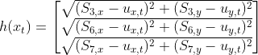
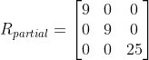
Task 6: Kalman filter testing on unknown trajectory
The main difference w.r.t. previous tasks is that for some elements of the trajectory there are, amid the 8 APs measurements, some that are missing (i.e. represented as NaN in matlab)
From the code perspective it means we can re-use the algorithm of tasks 4 and 5 but for each row of the measurements we need to dynamically resize some matrixes that will be then used in the iterative NLS and EKF:
Iterative NLS: delta_ro_k and H_k
EKF: H,h,R and use only valid in the update section

Slide 37
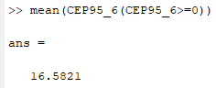
Task 6:
In case there are not enough :
We assign as estimated user location (U_{x},U_{y}) and velocity (V_{x},V_{y}) NaN
We assign to the accuracy evaluation metrics NaN

Slide 38
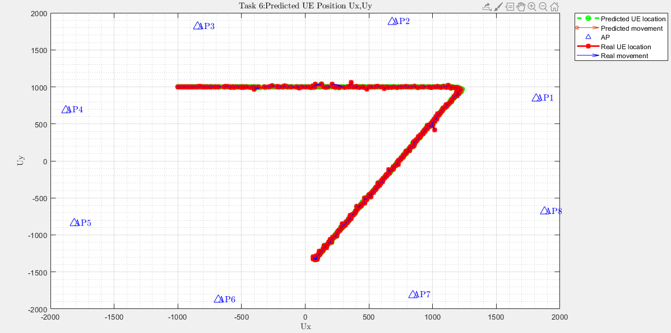
Task 6: Trajectory
LNSM_Project\Plots\Task6
A small note: Real UE location refers to the one calculated through iterative NLS

Slide 39
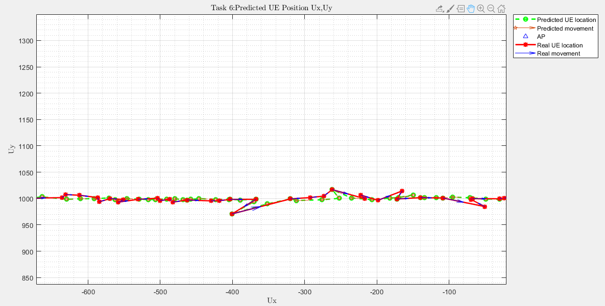
Task 6: Trajectory details

Slide 40
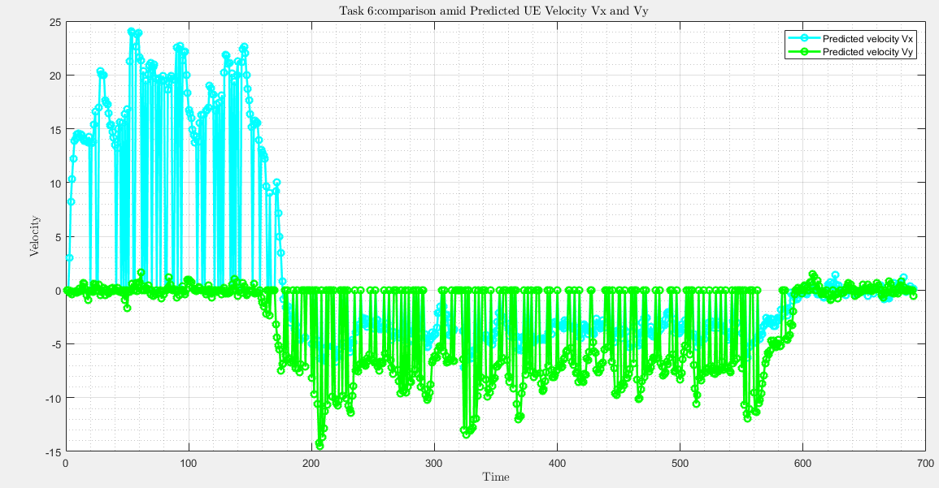
Task 6: Velocities

Slide 41
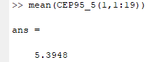
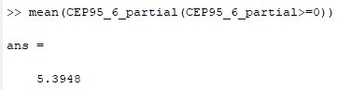
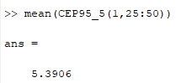
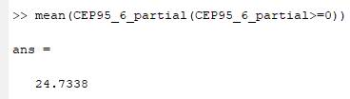
Task 6: Results
Task 6 has a much lower accuracy than tasks 4 and 5 due to the NaN measurements
Since the matrixes are dynamically resized, the greater is the number of NaN measurements in a row, the smaller the matrixes will be. The consequence is that we have a lower computation time w.r.t. tasks 4 and 5.
To check the correctness of our approach we can consider CEP95 for the first 19 rows where there not NaN:
And the CEP95 for the rows 25-50 (where there are NaN):

Slide 42
Contacts-Questions?
Carminati Fabio, mat. 919803
fabio3.carminati@mail.polimi.it
Gallone Emanuele, mat. 914114
emanuele.gallone@mail.polimi.it

